Slide 1
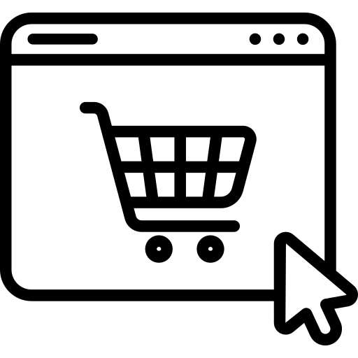


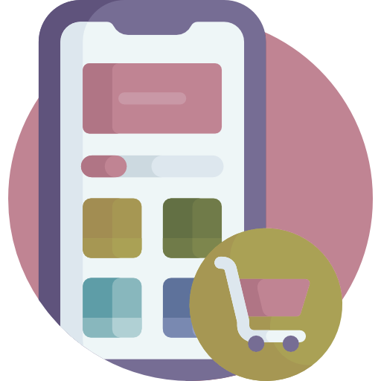
Ecommerce Database Design
For Business to Customer (B2C)
For Business to Customer & Business to Business
(B2C) & (B2B)

Slide 2


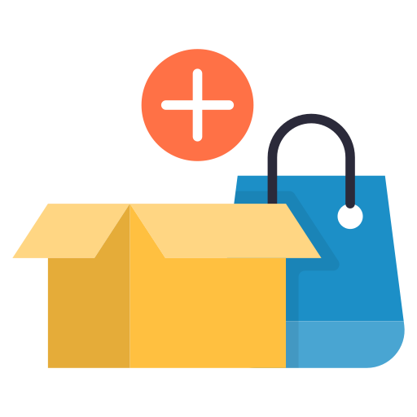
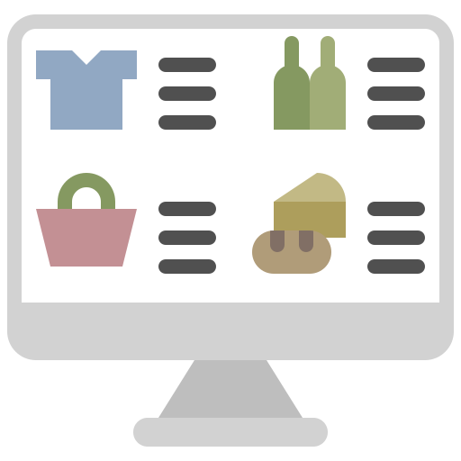

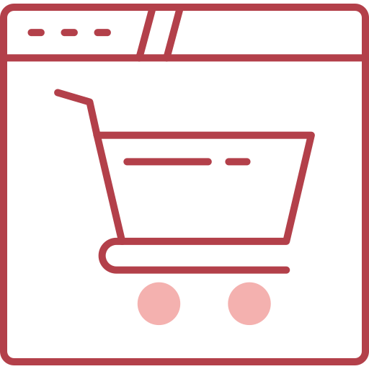
For Business to Customer (B2C)
Products
Tables
Category
Sub_category
Products
Brands
Product_skus
Product_attributes
orders
Order_items
Payment_detail
Shipping_address
refund
Business
Customers
Users
Addresses
Cart
Cart_items
offers
wishlist
review
analytics

Slide 3
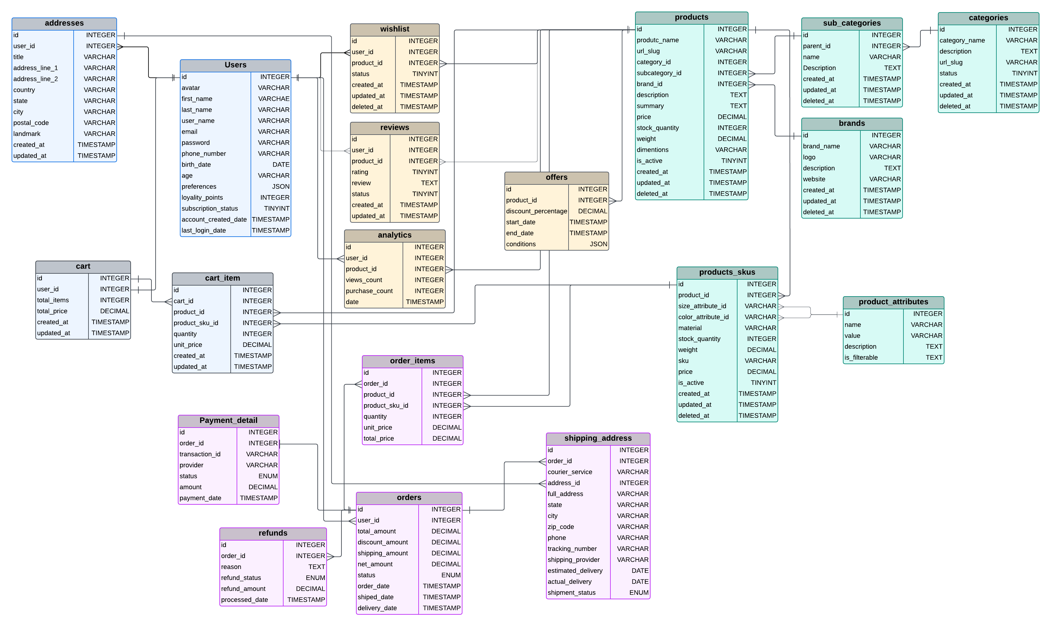
Business to Customer (B2C)

Slide 4
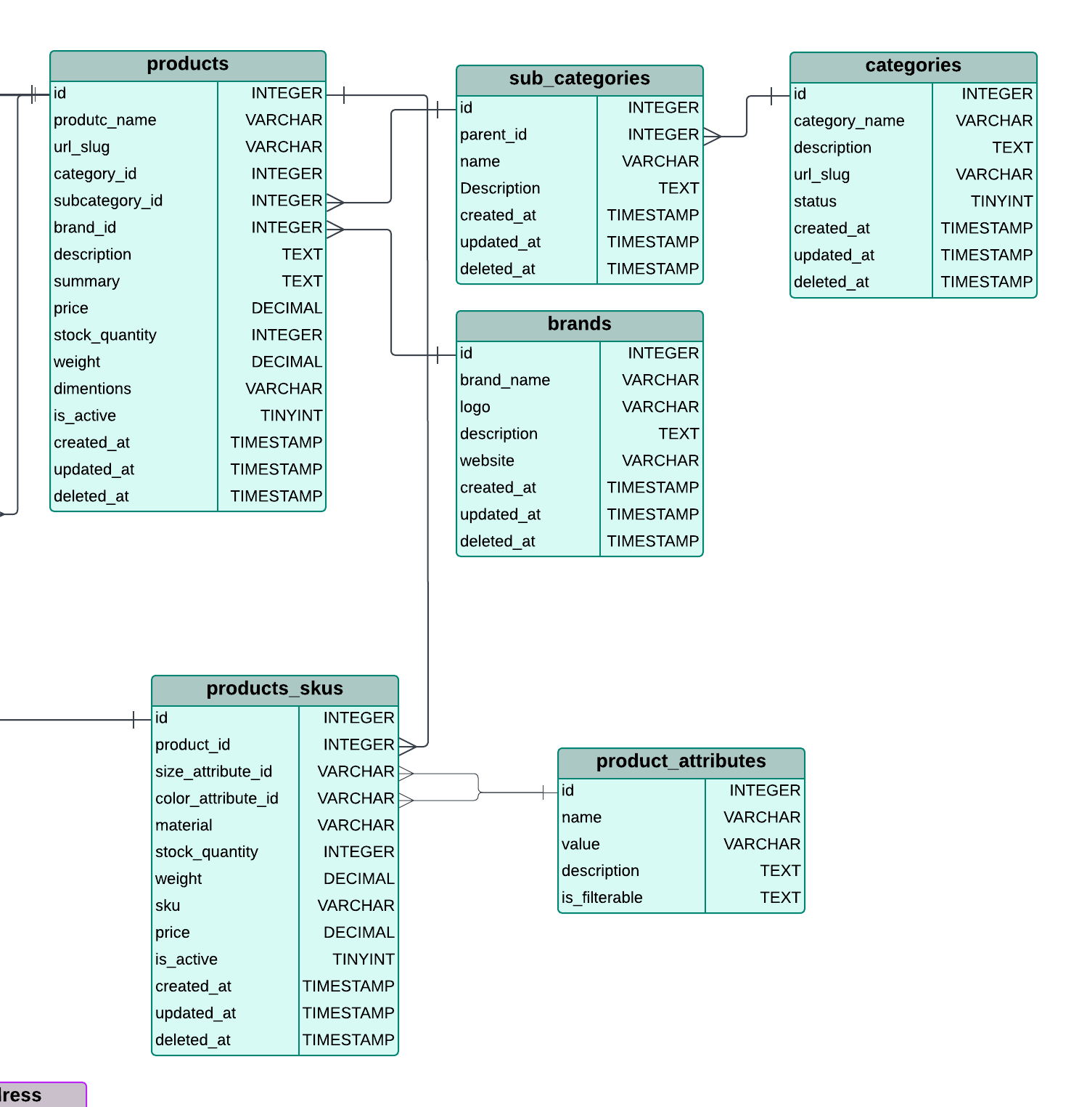
Categories This table organizes products into main classifications, like Electronics or Clothing. Each category acts as the parent for multiple subcategories, defining the broadest grouping in the hierarchy.
Sub_Categories This table refines categories into specific groups, linking directly to the Categories table. For example, within Electronics, you might have subcategories like Mobile Phones or Laptops
Brands represent the manufacturers or labels associated with products, such as Samsung or Nike. This table connects to the Products table, ensuring each product can be identified by its brand
Products This table is the core of the product catalog, linking categories, subcategories, and brands to each product. It holds detailed information like price, stock, and descriptions, forming the basis for product listings.
Product_Attributes Attributes define key product features, like size or color, that differentiate product variations. These attributes are later connected to SKUs to specify unique variants of products.
Product_SKUs This table stores specific product variants, such as a red T-shirt in size M. It links to the Products table and incorporates attributes like size and color, making each SKU a unique identifier for inventory management

Slide 5
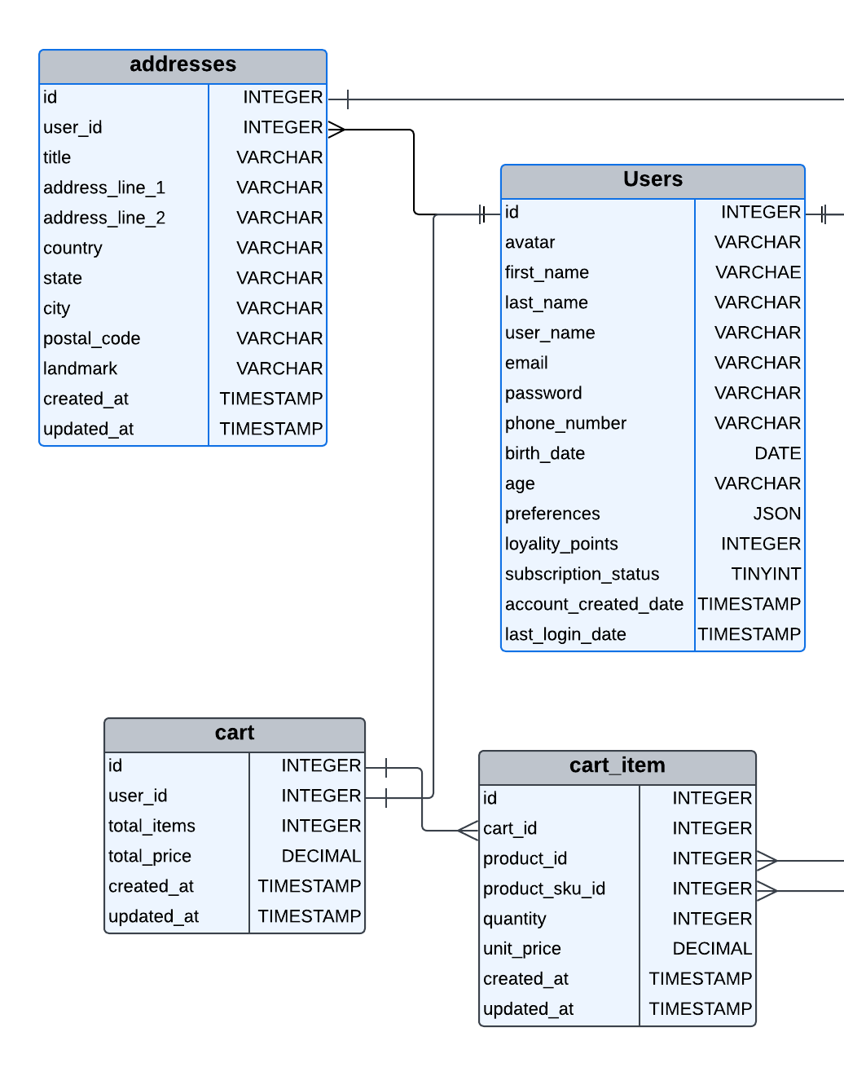
Users This table holds the profiles of all registered users, capturing essential details like names, contact information, preferences, and loyalty points. It serves as the central reference for user-related activities, including addresses and shopping behavior.
User_Addresses This table manages multiple addresses for each user, such as shipping and billing addresses. Linked to the Users table, it ensures users can maintain diverse location details for various transactions.
Cart This table tracks each user's active shopping cart, summarizing the total number of items and their cumulative price. It connects directly to the Users table, ensuring every cart is tied to a specific user.
Cart_Items This table keeps a detailed record of individual items in a user's cart, including product variants (SKUs), their quantities, and prices. It links to both the Cart and Products tables, forming a bridge between user activity and the product catalog.

Slide 6
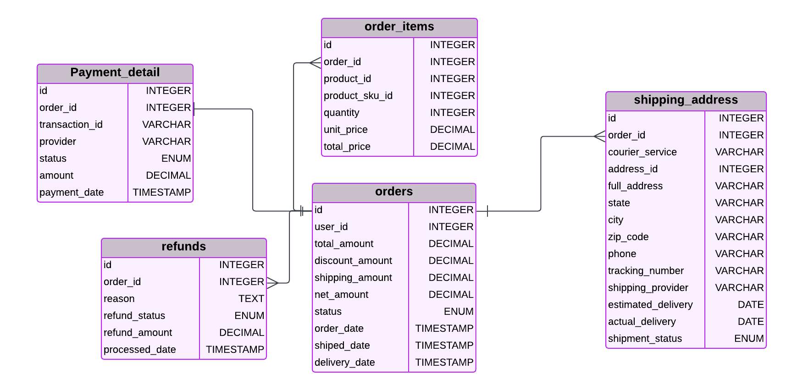
Orders This table records every order placed by users, storing details such as the total amount, discounts, shipping fees, and net amount. It tracks the order's lifecycle through statuses like Pending, Processing, Shipped, and Delivered, while also capturing key timestamps (order, shipment, and delivery dates). Each order is associated with a specific user.
Order_Items This table provides a breakdown of each order, listing the products purchased, their variants (SKUs), quantities, and pricing details. It links orders to products, forming the connection between a user's purchase and the inventory catalog.
Payments This table handles payment-related information for orders, including transaction IDs, payment providers, amounts, and statuses (e.g., Pending, Completed, Failed). It ensures every order has an associated payment record.
Shipping This table manages the shipping details for each order, including courier information, tracking numbers, and delivery addresses. It tracks shipment statuses (e.g., Pending, In Transit, Delivered) and timestamps for estimated and actual deliveries. It connects orders with users' addresses for efficient logistics.
Refund This table oversees refunds for orders, capturing reasons, statuses, and amounts refunded. It tracks when refunds are processed and links directly to orders, ensuring transparency in handling post-sale issues

Slide 7
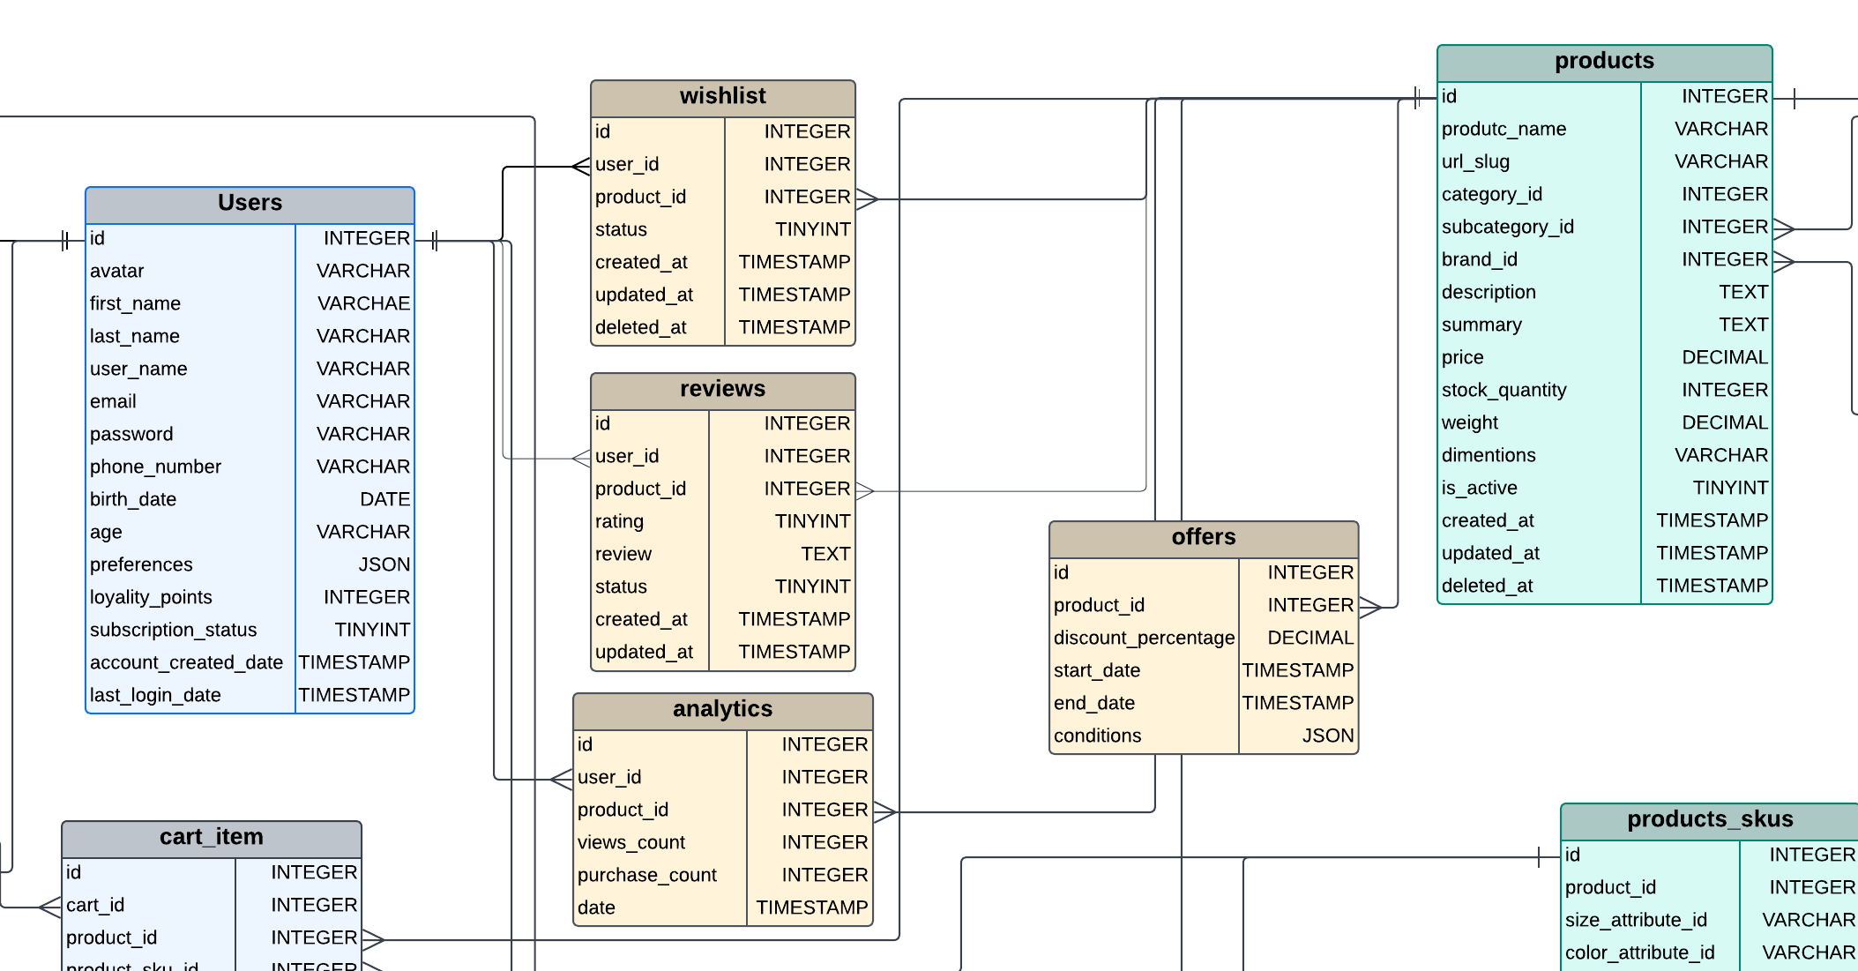
Wishlist
This table manages products saved by users for future consideration, including timestamps for creation and updates, and a status field. It connects to the Users, Products, and optionally the Product_Variants tables to track specific wishlist items.
Reviews
This table stores user ratings and feedback for products, with fields for review text, status, and timestamps for creation and updates. It is linked to the Users and Products tables to track which user reviewed which product.
.
Offers
This table stores promotional offers, including discount percentages, applicable product IDs, start and end dates, and customizable conditions in JSON format. It is linked to the Products table to apply offers to specific items.
.
Analytics
This table logs user interactions, such as product views and purchases, along with a timestamp and optional linkage to product variants. It is associated with the Users table and helps analyze customer engagement and product popularity.

Slide 8



For Business to Business & Customer (B2B) & (B2C)
Business
Business
Tables
Category
Sub_category
Products
Brands
Product_skus
Product_attributes
inventory
Users
Customers
sellers
Addresses
Cart
Cart_items
orders
Order_items
Payment_detail
Shipping_address
refund
offers
wishlist
review
analytics
Products
Customers

Slide 9
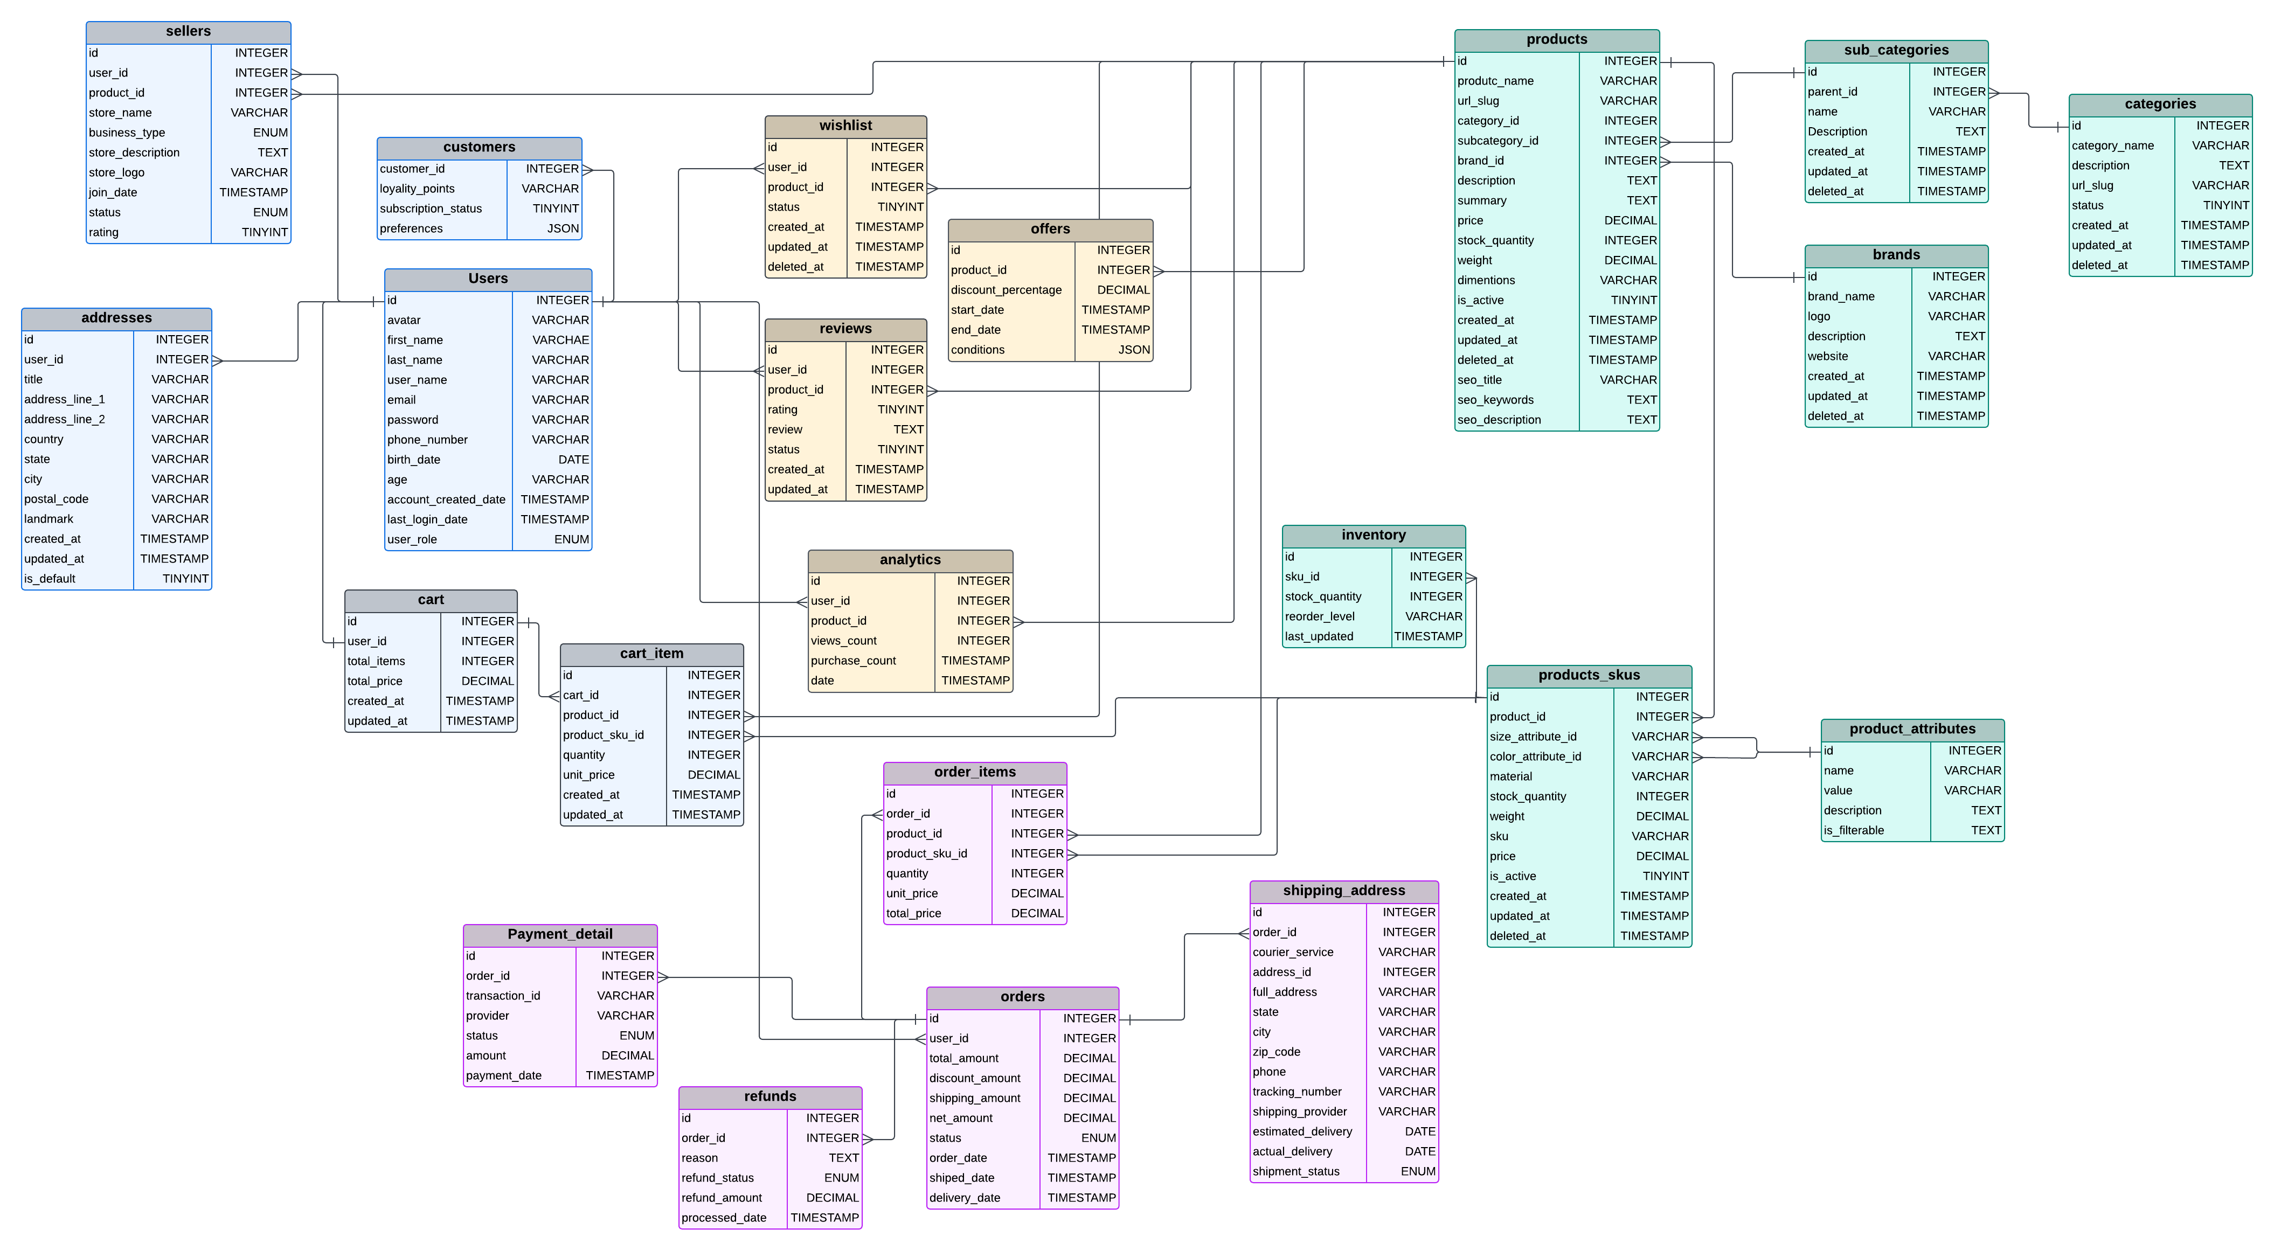
Business to Business & Customer (B2B) & (B2C)

Slide 10
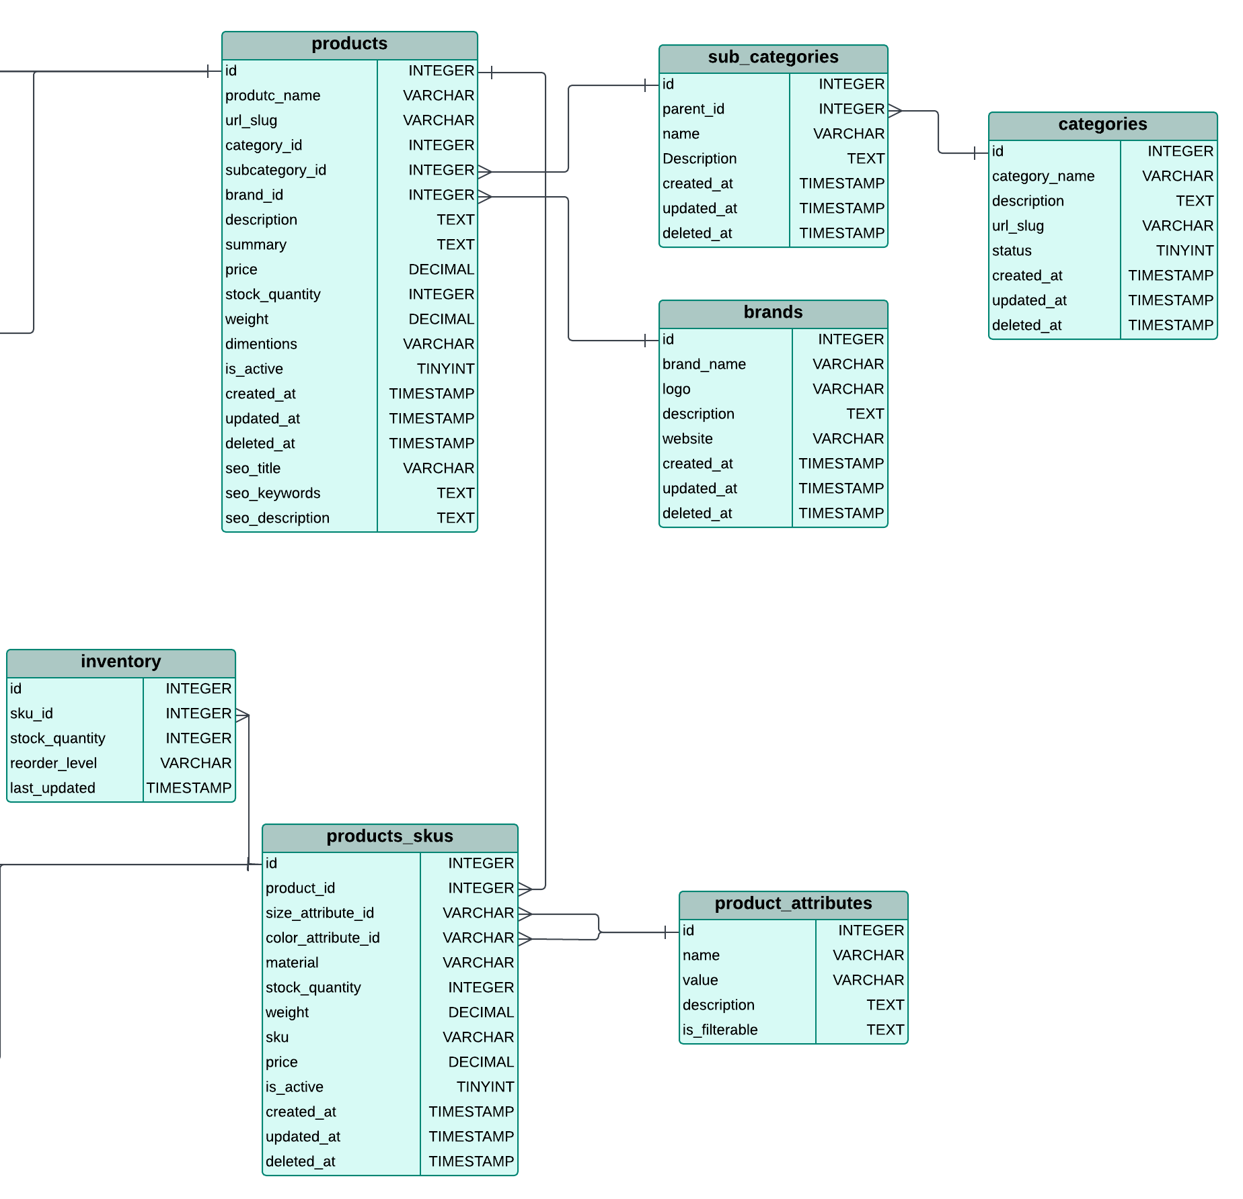
Categories
This table stores information about the main product categories, including the category name, description, URL slug, and status. It tracks creation, update, and deletion timestamps to manage the store's hierarchical structure
Sub_Categories
This table records details of subcategories linked to parent categories. It includes fields for the subcategory name, description, and timestamps, with a foreign key reference to the Categories table for hierarchical relationships.
Brands
This table holds information about product brands, such as brand name, logo, description, and website. It supports timestamps for tracking updates and deletions, ensuring brand details are well-maintained.
Products
This table contains detailed information about all products, including names, categories, subcategories, brands, price, stock, and dimensions. It is linked to the Categories, Sub_Categories, and Brands tables, providing a comprehensive product inventory with timestamps for changes.
Product_Attributes
This table defines customizable attributes for products, such as size, color, and material. It includes a field to mark attributes as filterable and supports descriptions to enhance product categorization.
Product_SKUs
This table manages stock-keeping unit (SKU) data for product variants, including size, color, material, stock, and price. It is linked to the Products table to track inventory variations and includes timestamps for updates.
Inventory
This table tracks stock levels of products using SKU identifiers, including the current stock quantity, reorder thresholds, and last updated timestamps. It helps maintain inventory accuracy and restocking processes

Slide 11
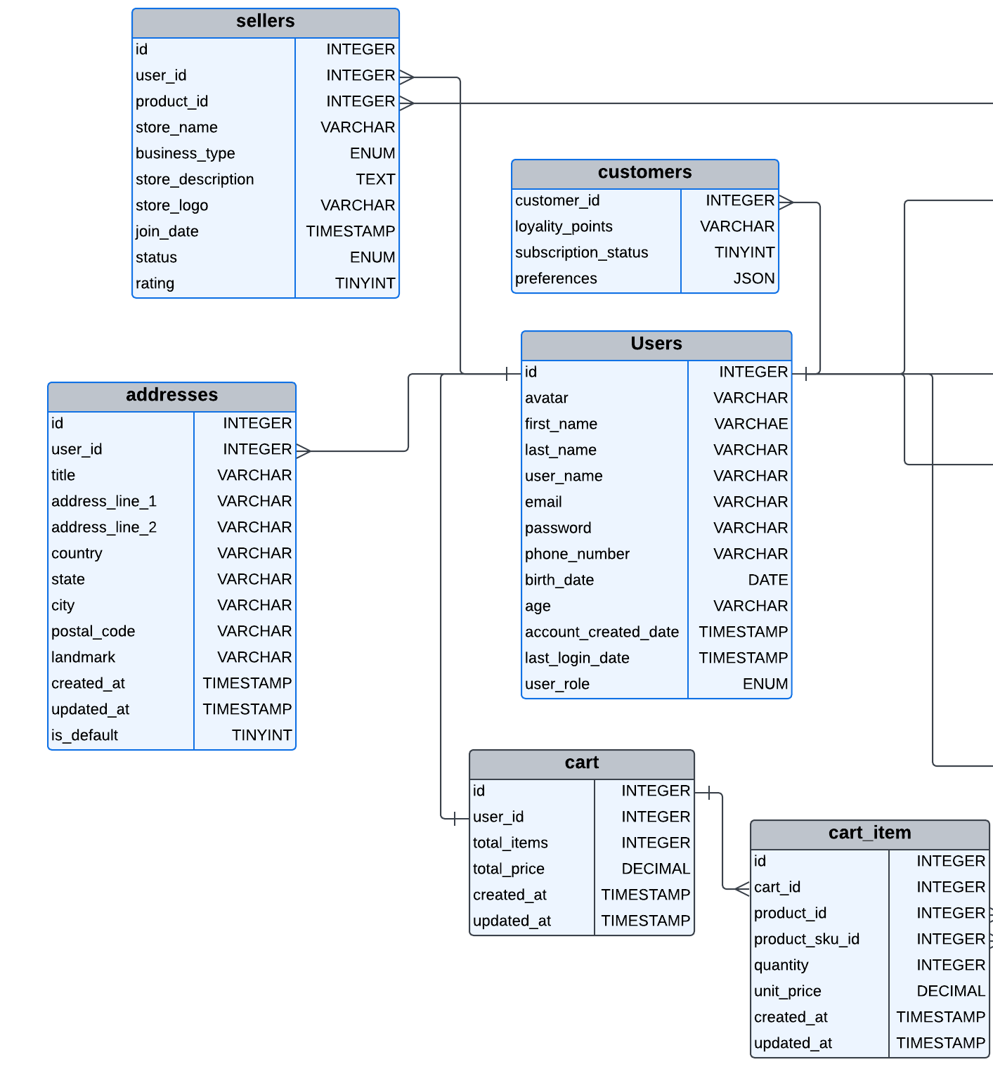
Users
This table stores information about registered users, including personal details like name, email, phone number, birth date, and account-related timestamps such as creation and last login. It ensures unique email and phone entries for user identification.
Customers
This table holds customer-specific data, including loyalty points, subscription status, and preferences stored as JSON. It helps manage customer engagement and personalization.
Sellers
This table contains seller details, including their associated user ID, store address, and business information. It tracks performance metrics and links to the Users table for user-specific details.
User_Addresses
This table manages user addresses for shipping or billing purposes, including fields for address details, country, state, city, and postal code. It is linked to the Users table to associate addresses with specific users
Cart
This table tracks shopping cart information for users, including total items and total price. It is linked to the Customers table to manage cart activity and ensure unique user-cart relationships
Cart_Items
This table details the items added to carts, including product and SKU identifiers, quantities, and total prices. It links to the Cart, Products, and Product_SKUs tables for comprehensive cart item tracking.

Slide 12
Orders This table records every order placed by users, storing details such as the total amount, discounts, shipping fees, and net amount. It tracks the order's lifecycle through statuses like Pending, Processing, Shipped, and Delivered, while also capturing key timestamps (order, shipment, and delivery dates). Each order is associated with a specific user.
Order_Items This table provides a breakdown of each order, listing the products purchased, their variants (SKUs), quantities, and pricing details. It links orders to products, forming the connection between a user's purchase and the inventory catalog.
Payments This table handles payment-related information for orders, including transaction IDs, payment providers, amounts, and statuses (e.g., Pending, Completed, Failed). It ensures every order has an associated payment record.
Shipping This table manages the shipping details for each order, including courier information, tracking numbers, and delivery addresses. It tracks shipment statuses (e.g., Pending, In Transit, Delivered) and timestamps for estimated and actual deliveries. It connects orders with users' addresses for efficient logistics.
Refund This table oversees refunds for orders, capturing reasons, statuses, and amounts refunded. It tracks when refunds are processed and links directly to orders, ensuring transparency in handling post-sale issues

Slide 13
Wishlist
This table manages products saved by users for future consideration, including timestamps for creation and updates, and a status field. It connects to the Users, Products, and optionally the Product_Variants tables to track specific wishlist items.
Reviews
This table stores user ratings and feedback for products, with fields for review text, status, and timestamps for creation and updates. It is linked to the Users and Products tables to track which user reviewed which product.
.
Offers
This table stores promotional offers, including discount percentages, applicable product IDs, start and end dates, and customizable conditions in JSON format. It is linked to the Products table to apply offers to specific items.
.
Analytics
This table logs user interactions, such as product views and purchases, along with a timestamp and optional linkage to product variants. It is associated with the Users table and helps analyze customer engagement and product popularity.

